Slide 1
Occurrence Versus Abundance in Species Distribution Models
Most SDM are based on occurrence
Biodiversity data are primarily the record of the occurrence of an organism at a date and location
Few broad-scale monitoring projects collect counts of individual organisms and are protocol-driven
Notes:
42 Pied Stilts
1 Australian Ibis

Slide 2
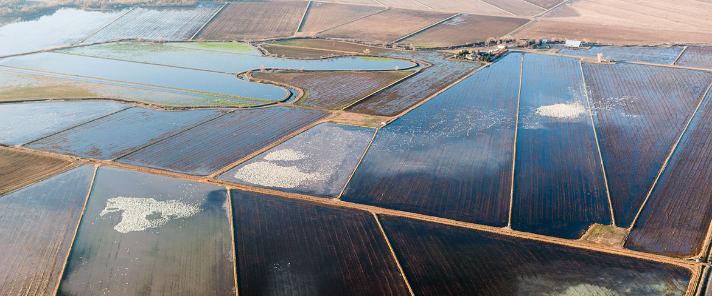
Bird Returns Dynamic Conservation in the Central Valley of California
Abundance models improve spatial and temporal prioritization of conservation resources
Alison Johnston, Daniel Fink, Mark D. Reynolds, Wesley M. Hochachka, Brian L. Sullivan,
Nicholas E. Bruns, Eric Hallstein, Matt S. Merrifield, Sandi Matsumoto & Steve Kelling
Submitted

Slide 3
Occurrence often considered a surrogate of abundance.
However: Relationship varies with species natural history
(i.e., solitary or social) and can vary seasonally
or across spatial scales

Slide 4
Challenges in Creating a Regression Model for Abundance
SDM must handle large numbers of zero counts
SDM must handle rare (but significant) high counts
Many migratory species change habitat preferences seasonally—statistical non-stationarity
Animals move around and are often hard to detect
Data are sparse

Slide 5
Experiment
We describe and validate a predictive model of spatial and temporal variation in abundance
The model is capable of adapting to a variety of non-stationary, spatiotemporal abundance patterns based on surveillance monitoring data.
We compare models of occurrence and abundance for a range of species, seasons, and at two spatial resolutions.

Slide 6
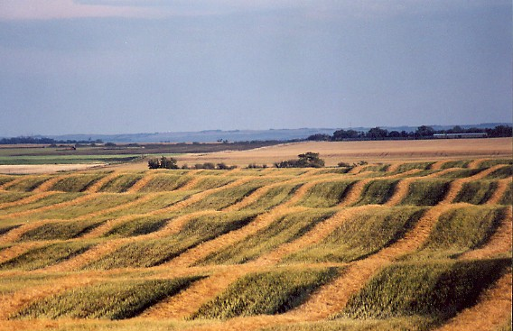
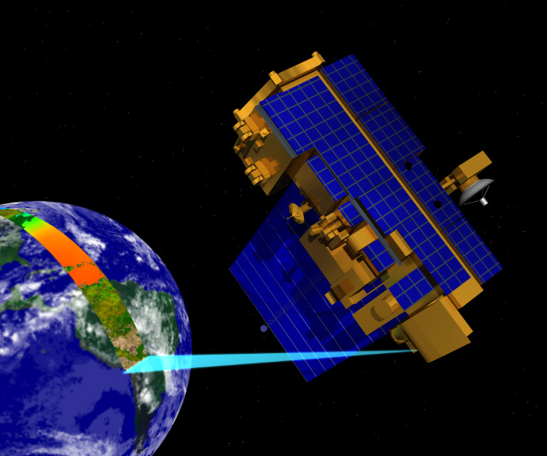
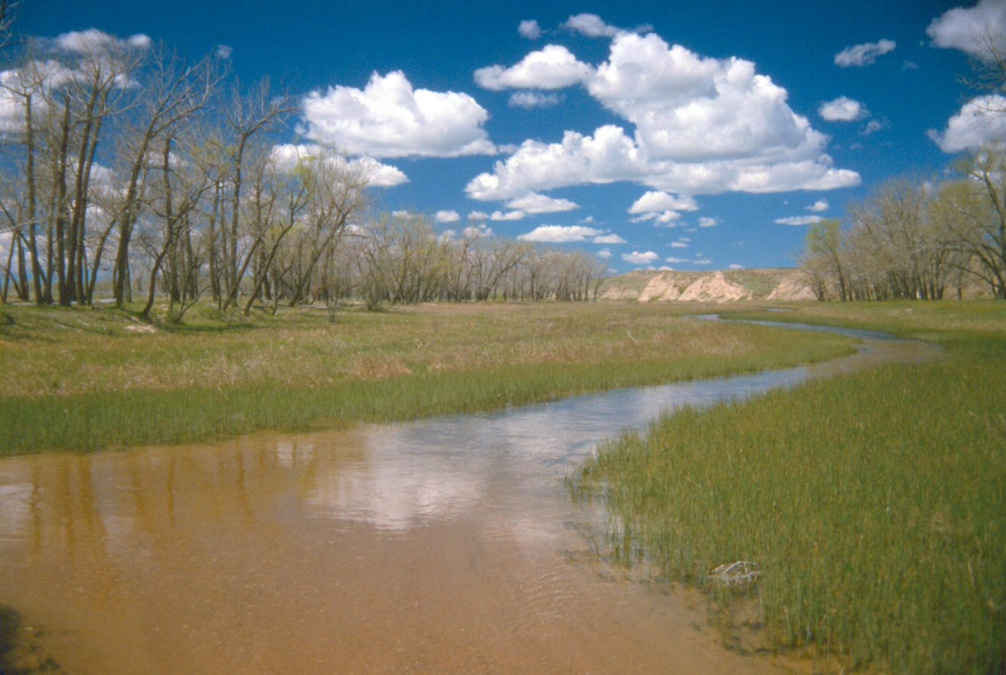
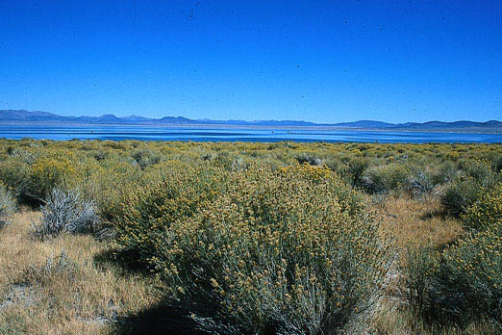
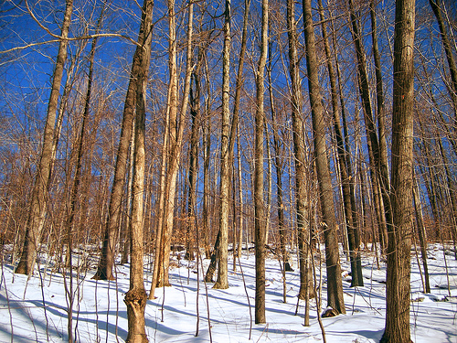
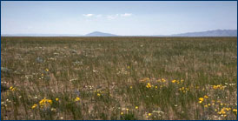
eBird
Observed Count
Lat - Lon
Year
Day of the Year(1-365)
Checklists
Observation Effort
Observation Time
Number of Observers
Stationary/Traveling Protocol
MODIS Landcover
2011
13 Classes
% coverage within1.5 km pixel
Elevation
…
NDVI / EVI
Productivity
Multi-wavelength Spectra
Cropscape
MODIS – Remote sensing data
Notes:
eBird- 250 million records from 15 million checklists
Around each location @4.5 million locations, we want high res

Slide 7
Using a Mixture Model to Divide and Recombine
A supervised learning model relates predictors X to observed occurrences y
Divide
Divide study extent into regions
Restrict each base model to a region
Recombine
Predictions at location s are made by averaging across the models that contain s
Region
s
n(s) = number of models containing s

Slide 8
Partitioned data into overlapping spatiotemporal neighborhoods.
“Slice and dice” ST extent into stixels
With sufficient overlap
Adapt to different dynamics
Temporal Design:
40 day intervals
80 evenly spaced windows
throughout year
Spatial Design
For each time interval
Random Sample rectangles
(12 deg lon x 9 deg lat)
Minimum 25 unique locations.

Slide 9
Two-stage model for relative abundance to address zero inflation
Stage 1
Used a binary (i.e., presence/absence) response of the zi-BRT to identify suitable habitat. (similar to occurrence)
Stage 2
Locations with suitable habitat and abundances were weighted heavier in the model
{square root of the number +1}
Notes:
Zero inflated Boosted Regression Tree

Slide 10
Relative Abundance or Occurrence Estimates
Calculated across the cells of a 3km x 3km
grid
The quantity estimated was the expected number of birds or occurrence of a given species that a typical eBird participant would count on a search from 7-8 am while traveling 1 km

Slide 11
June 1-2 Birds
Notes:
Get rid of middle
Talk about frequency and abundance is useful
Abundance more information on places

Slide 12
January 1-2 Birds

Slide 13
January > 100 Birds

Slide 14
June > 100 Birds

Slide 15
June 1-2 Birds January
June > 100 Birds January

Slide 16
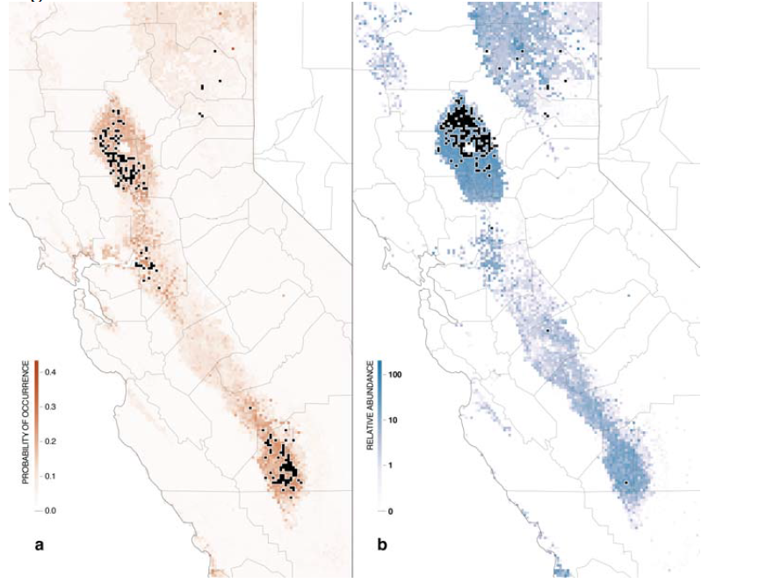
Notes:
Estimated occurrence and abudance for Northern Pintail mid-January. Black regions denote the 200 locations with the highest estimated occurrence or abundance
Locations for abundance correlated with Pintail abunance made from aerial surveys >90 of all NOPI in Sacremanto Valley

Slide 17
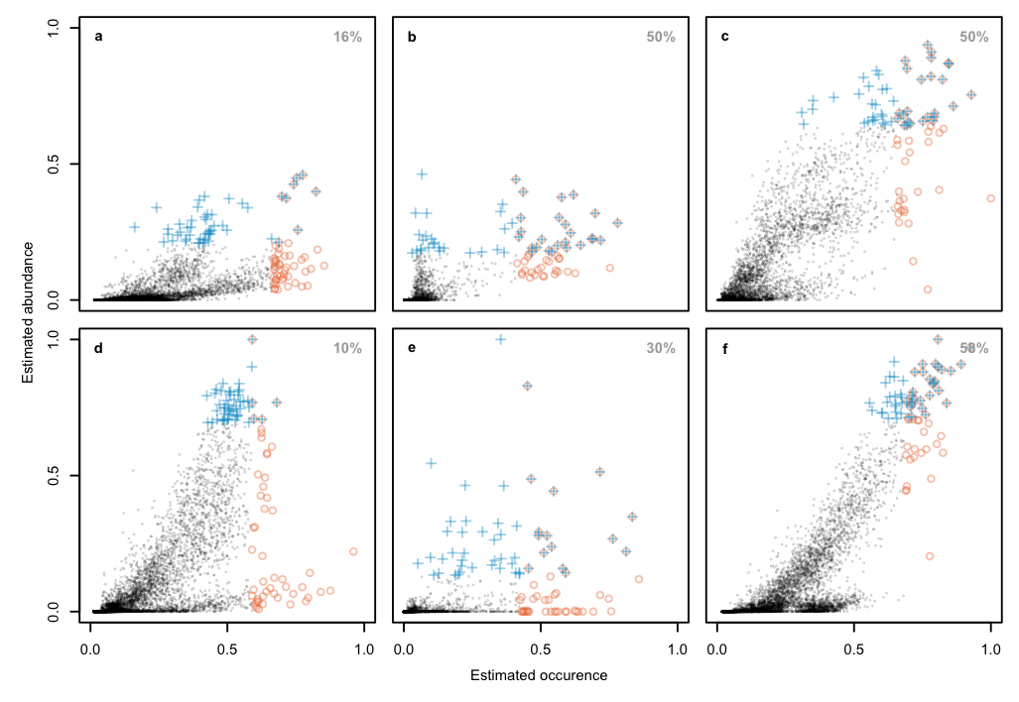
Northern Pintail
Sandhill Crane
Dunlin
Least Sandpiper
Western Sandpiper
Greater Yellowlegs
Notes:
Top 50 Abunance locations crosses
Top 50 occurrence locations circles
Grays are overlaps
Little overlap between locations.

Slide 18
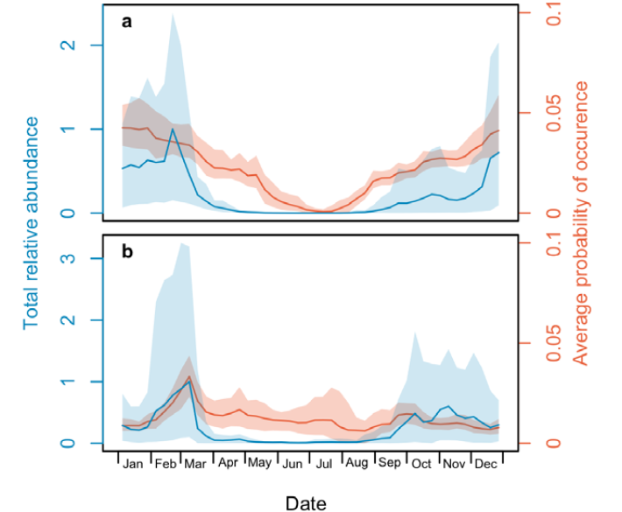
Notes:
Arrival and departure dates are more clearly defined with abundance

Slide 19
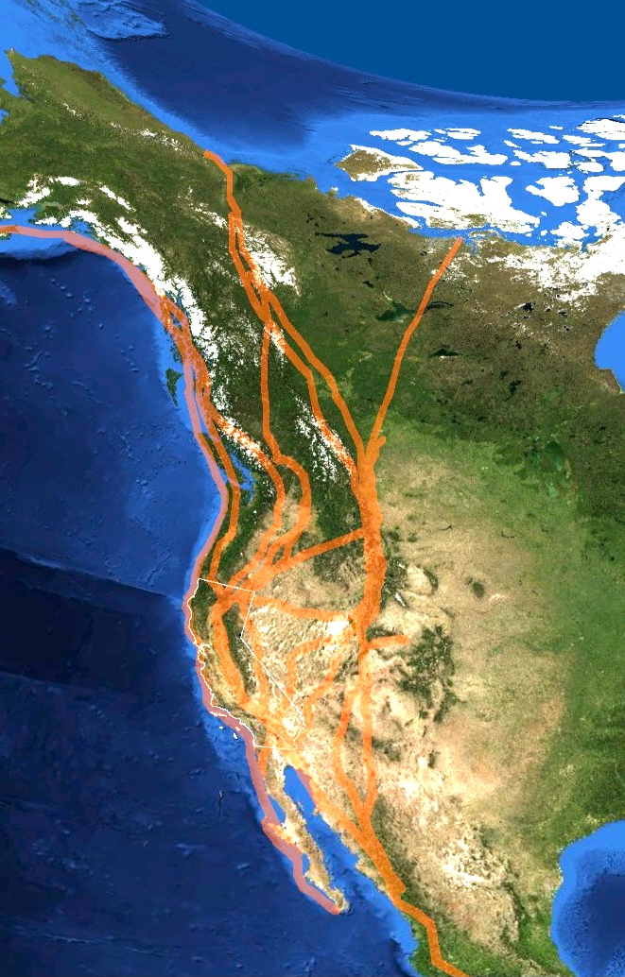
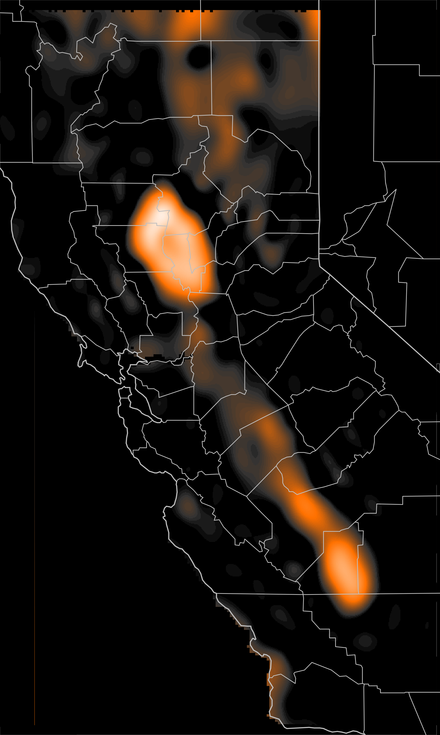
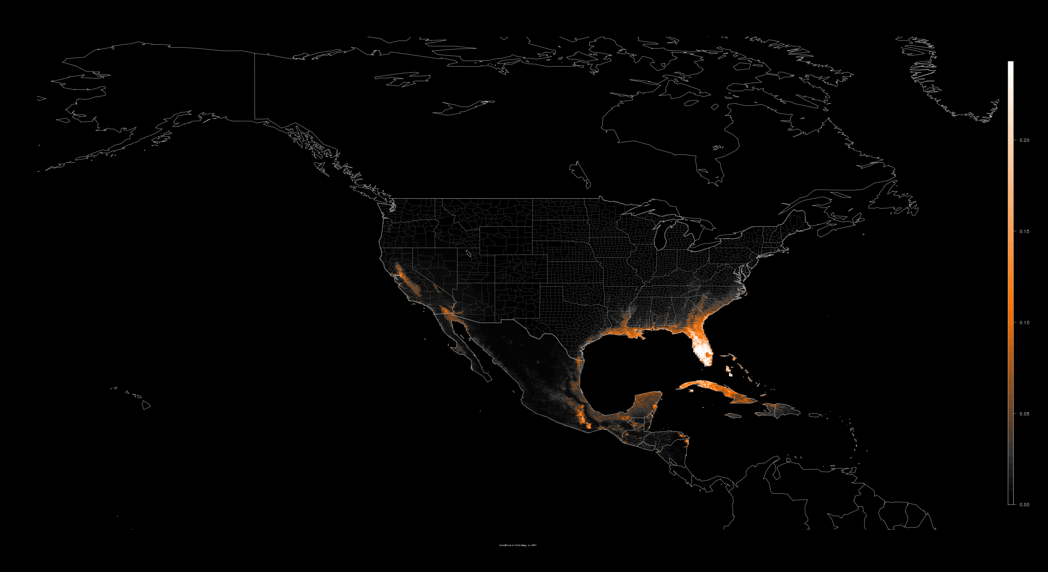
Avian Abundance Estimation Across the Pacific Flyway for Full Life-cycle Conservation Planning
NASA MODIS and ASTER earth imagery, bird observations gathered by citizen-science volunteers, big data analytics, and a market-based conservation approaches are applied to fine-scale conservation of bird habitat
Results: 20,000 more acres of habitat for migrating waterbirds in California
1
2
3
4
Farmers
Submit Bids
Bids selected based on targeted estimates
Pacific Migration Flyway
eBird Data
Models
Targeted
Estimates
Reverse Auction and Bid Selection
|‌ 19
|‌ 19
Notes:
Bird observations from the Citizen Science Project eBird is joined with NASA earth imagery high performance computing and data intensive analytics provide habitat conservation at a very fined scale—at the rice field.
BirdReturns — Big data analytics and market-based approaches for dynamic conservation of migratory bird habitat have made an additional 20,000 acres of suitable habitat for migrating waterbirds in California.
1. The Pacific Flyway is a major migration conduit for waterbirds in the Western Hemisphere.
2. Bird observations from the Citizen Science Project eBird are joined with NASA MODIS and ASTER earth imagery, high performance computing, and data intensive analytics to predict the location of bird populations with fine spatial resolution.
The map shows the weekly change in occurrence of waterbirds as they move from their wintering grounds to their breeding grounds. The map shows a 1-year cycle beginning in January and ending in December. Note how you can see flyways and migration stopover information as birds move from Mexico and the Caribbean to northern Canada and Alaska. Brighter (hotter we call these heat maps) areas indicate birds at higher abundance.
3. eBird models can be used across scales—hemispheric (2) down to a rice field (3). Waterbird abundance estimates are provided to TNC land managers and economists at 1.5 km squared resolution are made for waterbirds in California’s Central Valley who use these data to decide which fields should be targeted for flooding . The brightest (hottest) locations on the map (i.e. the northern part of the Sacramento Valley) were areas targeted by the TNC.
The TNC in California uses a REVERSE AUCTION approach to solicit bids from rice growers to keep fields flooded during migration. TNC then pays farmers to keep fields flooded during critical migration times. TNC was able to enroll 20,000 acres of temporary habitat that maximized waterbird productivity for less than 1% of the cost of purchasing conservation easements.

Slide 20
Conclusions
Little performance risk in using abundance over occurrence
Abundance and occurrence relationship nonlinear
Abundance identifies timing and location of species more precisely
Timing of migration peaks
Identification of locations with highest numbers
Abundance allowed TNC to be more selective allowing them to get more high quality locations for less money, allowing TNC to enroll more high quality acres.

Slide 21
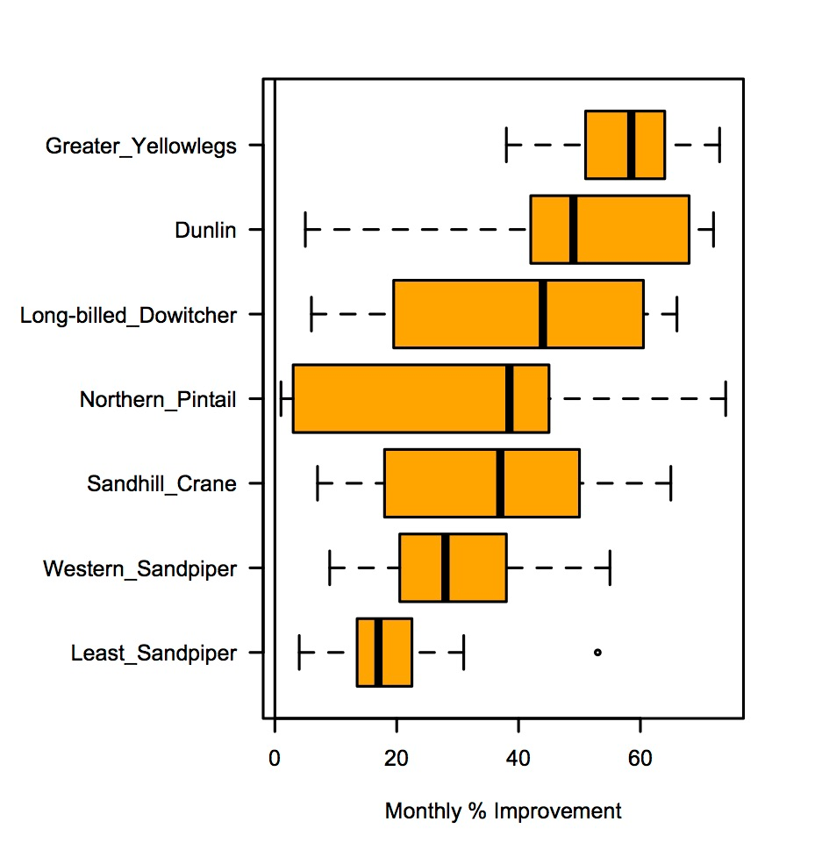
Notes:
Estimates of abundance and occurrence are correlated but are significantly non-linear
Estimates of high abundance have relatively low estimates of occurrence
Pintail Top Winter Spring
Crane Bottom Winter Spring

